Slide 1
Sport

Slide 2
Swimming

Slide 3
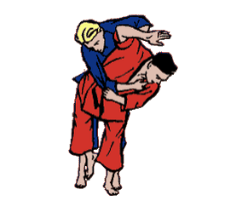
Judo

Slide 4
Golf

Slide 5
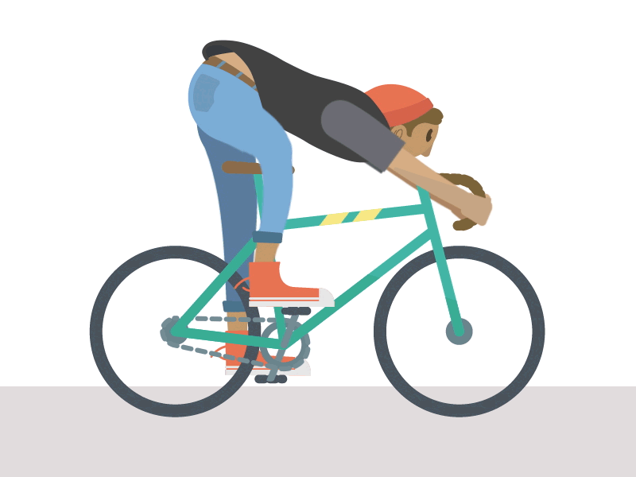
Cycling

Slide 6
Hockey

Slide 7
Badminton

Slide 8
Volleyball

Slide 9
Tennis

Slide 10
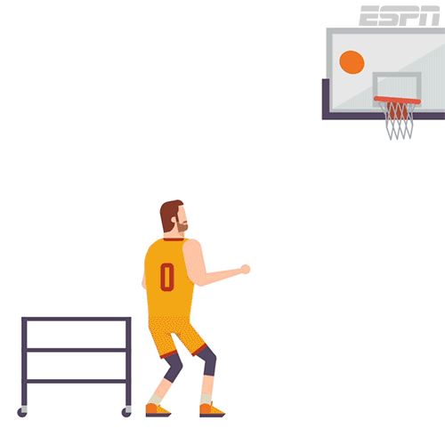
Basketball

Slide 11
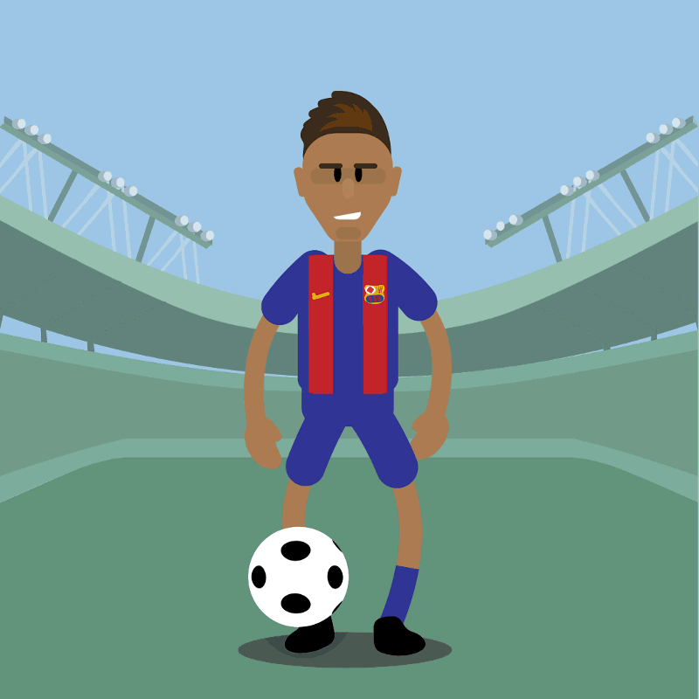
Football

Slide 12
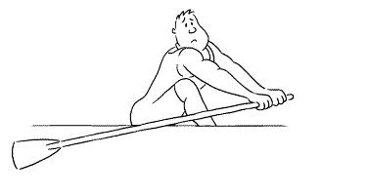
Rowing

Slide 13
Horse riding

Slide 14
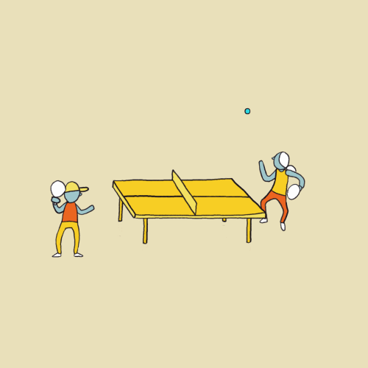
Table tennis

Slide 15
Sailing

